Slide 1


K.RAMAKRISHNAN COLLEGE OF TECHNOLOGY
(AUTONOMOUS), TRICHY
CAR RENTAL SYSTEM
PRESENTED BY SUPERVISOR
Keerthana K Mrs.K.Valli Priyadharshini M.E., (PhD),
2303811710422076 AP/CSE.

Slide 2
PRESENTATION OVERVIEW
Objective
Project Introduction
Problem Statement
Methodologies (Programming concepts relevant to problem statement)
Architecture of the proposed system
List of Modules
7. Merits
8. Results and Discussion
9. Queries

Slide 3
OBJECTIVE
The objective of the code is to create a functional Car Rental System that allows users to easily search, view, and book cars through a graphical user interface (GUI). The system enables users to search for cars based on their preferences, display available cars along with their rental prices, and book a car by entering details like customer name, rental days, and payment mode. It also calculates the total cost based on the car’s daily rate and rental duration. The program ensures that user inputs are validated for accuracy and proper formatting, while also handling errors gracefully to prevent crashes. The interactive GUI, built using AWT components, aims to provide an intuitive and user-friendly experience. The core purpose of the system is to automate the car rental process, making it easier for users to rent vehicles while maintaining real-time updates on car availability and pricing, thus simplifying car rental operations for both users and businesses.

Slide 4
INTRODUCTION
The Car Rental System is a Java-based application designed to simplify the car rental process for both customers and rental companies.
It provides an online platform where customers can search for available cars, book rentals, and manage reservations efficiently.
The system enables rental companies to manage their fleet, track reservations, and process payments seamlessly.
Core functionalities include real-time availability checks, secure payment processing, and role-based access for customers and administrators.
Using Java’s object-oriented principles, the system ensures modularity, scalability, and maintain ability.
The system promotes convenience, transparency, and reliability for all users, making the rental process straightforward and efficient.

Slide 5
PROBLEM STATEMENT
Design and develop a Car Rental System that allows customers to search, book, and manage car rentals online. The system should enable car rental companies to manage their fleet, track reservations, and process payments efficiently. The goal is to streamline the car rental process for both customers and companies, ensuring convenience, transparency, and reliability.

Slide 6
METHODOLOGIES
1.Class and Object: The CarRentalSystem class represents the blueprint of the car rental system, and objects like Label, Button, and TextField are instances of GUI components.
2.Inheritance: The CarRentalSystem class extends the Frame class, inheriting properties and methods for creating and managing a GUI window.
3.Encapsulation: The program encapsulates data such as cars and booked Cars within the class, restricting direct access and using methods to manipulate them.
4.Polymorphism: The action Performed method uses polymorphism to handle various events based on the source of the action (e.getSource()).

Slide 7
METHODOLOGIES
4.Event Handling: The program uses the ActionListener interface to handle button click events like searching, booking, and displaying all cars. The Window Adapter class is used to handle the window-closing event, ensuring proper termination of the application.
5.Exception Handling (try-catch): Though this implementation does not explicitly show exceptions, Java exception handling could be incorporated, particularly for scenarios like invalid input or unsuccessful payment processing. The try-catch blocks would be used to handle exceptions such as InputMismatchException for invalid user input.

Slide 8
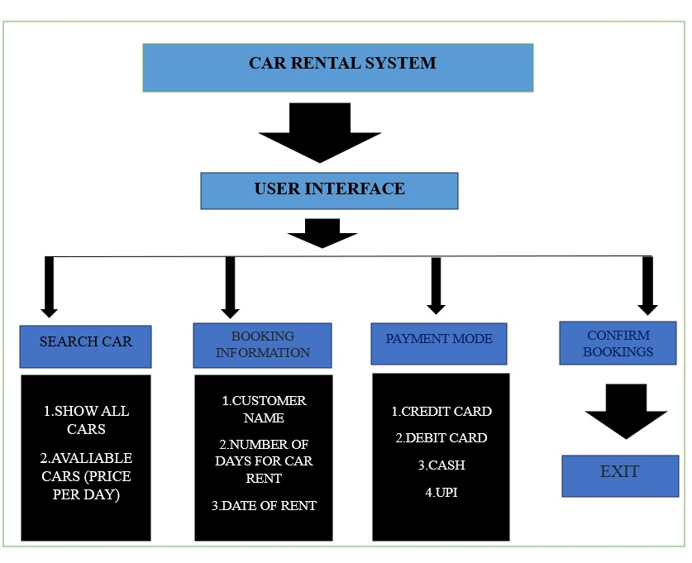
ARCHITECTURE OF THE PROPOSED SYSTEM

Slide 9
LIST OF MODULES
1.CarRentalGUI Module: Handles the graphical user interface (GUI) for the system. This module would include the setup and layout of the window, including buttons, labels, text fields, and other components for user interaction.
2.CarInventory Module: Manages the list of cars available for rent. This module is responsible for storing and retrieving car details like name and price per day. HashMap to store the car data (key-value pairs of car names and prices).
3.CarBooking Module: Handles car booking functionality. This includes validating user input, calculating rental costs, and updating the availability of cars once a booking is made. Input fields for customer name, rental days, payment mode, and date of rental. It also manages interactions with the HashMap that stores booked cars.

Slide 10
LIST OF MODULES
4.CarSearch Module: Provides the search functionality for users to filter cars based on their search query. Text field for search input, and a mechanism to filter cars displayed in the GUI.
5.PaymentProcessing Module: Manages payment details for bookings. While the code doesn’t actually process real payments, this module would handle the payment mode selection and validation. Choice for selecting payment options (Credit Card, Debit Card, Cash, UPI).

Slide 11
MERITS
1.User-Friendly Interface: The system provides a simple and intuitive user interface, making it easy for users to navigate and use the system.
2.Efficient Data Storage: The system uses a HashMap to store car data, providing efficient data retrieval and manipulation.
3.Robust Exception Handling: The system handles exceptions for invalid user input, preventing the system from crashing and providing a better user experience.
4. Modular Code: The code is well-structured and modular, making it easy to maintain, modify, and extend the system.
5.Standard Java Coding Conventions: The code follows standard Java coding conventions, making it readable and understandable by other developers.
6. Booking Management: The system allows users to book cars and displays booking details, making it easy to manage car rentals.

Slide 12
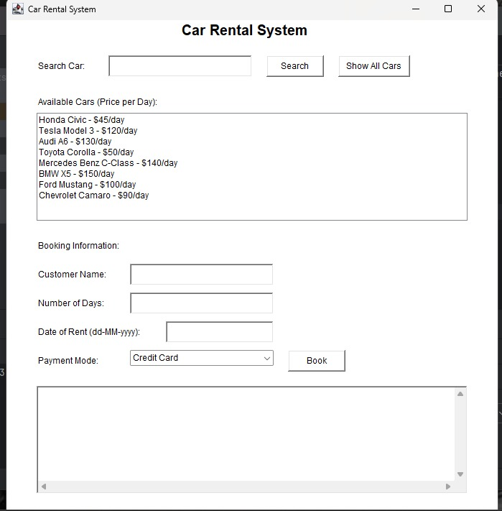
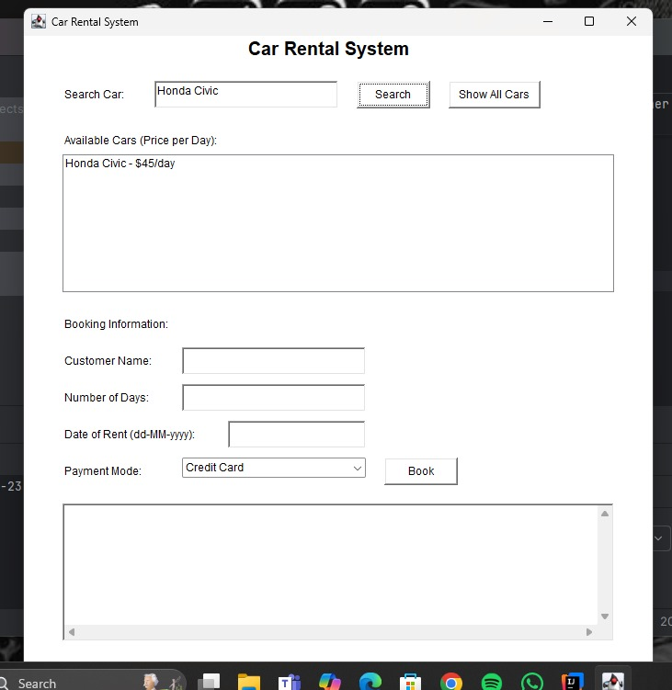
RESULT AND DISCUSSION

Slide 13
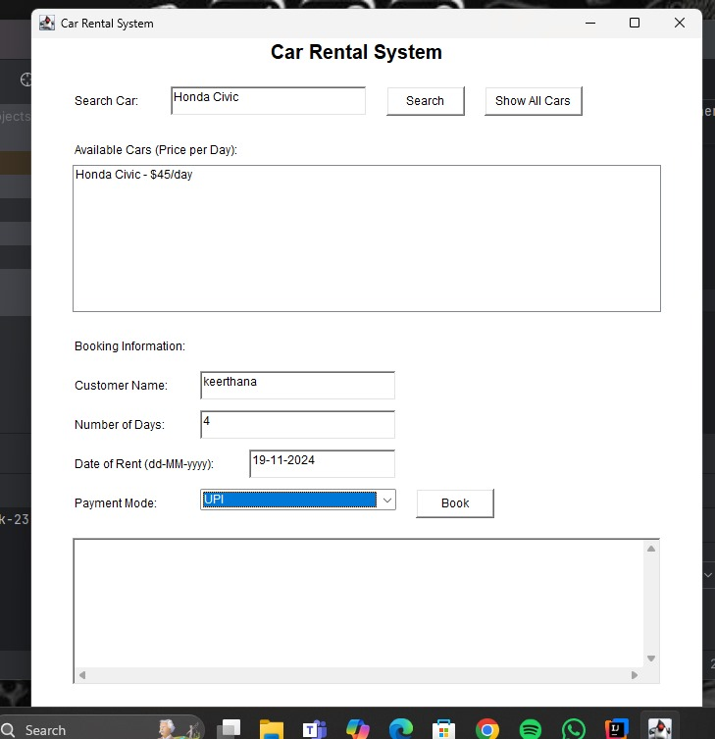
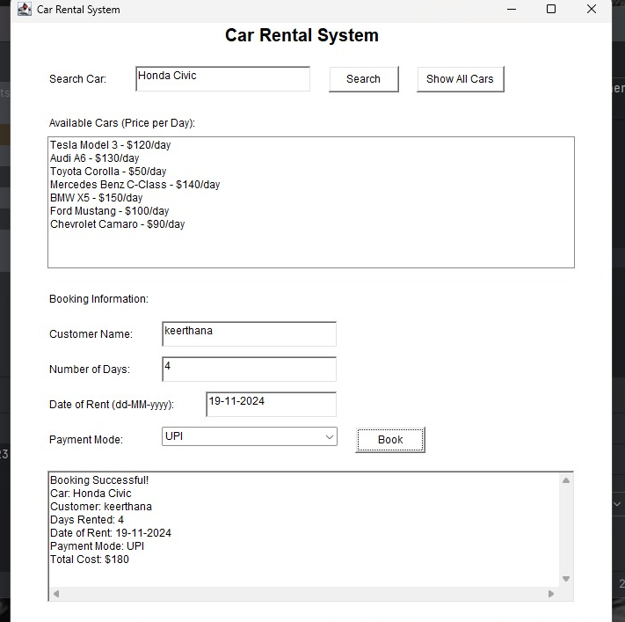
RESULT AND DISCUSSION

Slide 14
QUERIES
.

